Slide 1

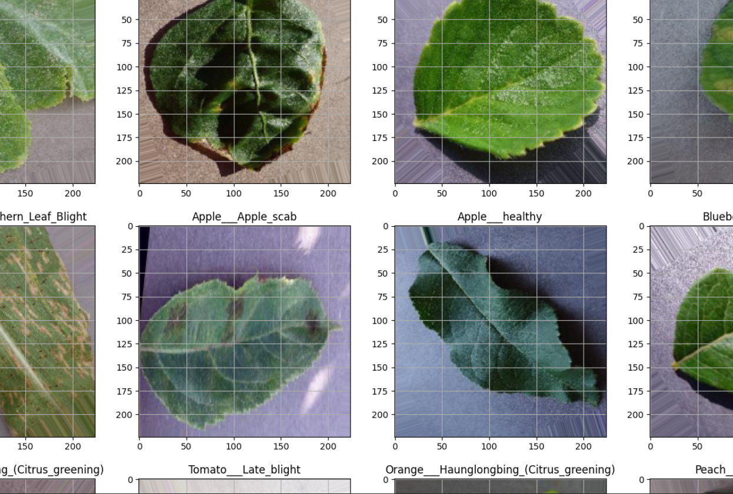
Rajarambapu Institute of Technology, Rajaramangar
Department – CSE(AL&ML)
Project Title: Plant Disease Detection
Objectives
Technical Specifications
Student Name:
1. Anushka Walvekar 2317004
2. Anushka Babar 2317008
3. Shreya Patil 2317009
4. Gauri Patil 2317012
To study and understand common plant diseases and their visual symptoms.
To collect and prepare a dataset of healthy and diseased plant leaf images.
To implement image preprocessing techniques for quality enhancement..
To evaluate the model’s performance using suitable metrics
SOFTWARE USED:
▪ VS CODE
▪ EXCEL SHEET
▪ CNN Method
▪ EDA Method
▪ VGG from Deep Learning
Need Statement:
Project model and Project Pic
Results and Discussion
There is a growing need for an efficient, accurate, and automated solution to detect and classify plant diseases, as traditional methods are time-consuming, error-prone, and require expert intervention. Farmers often struggle with identifying diseases at early stages, which impacts crop yield and the economy.
The machine learning model accurately classified plant diseases using leaf images, with strong performance across key metrics. Data augmentation improved its generalizability. Visual tools like confusion matrices and accuracy charts confirmed its reliability. With further development for mobile use, it can empower farmers with real-time, AI-based disease detection.
Problem Statement:
Figure 1: Circuit Diagram
Inference and Future scope
To create a machine learning-powered system that has the capability to automatically detect plant diseases from images of leaves.
Increased Dataset: Adding more variety of plant types and disease classes, as well as actual field images, would enhance the model's robustness and generality.
Mobile Application Deployment: Porting the trained model into a mobile application using light-weight frameworks (e.g., TensorFlow Lite) would deploy it among farmers in remote locations.

